Slide 1
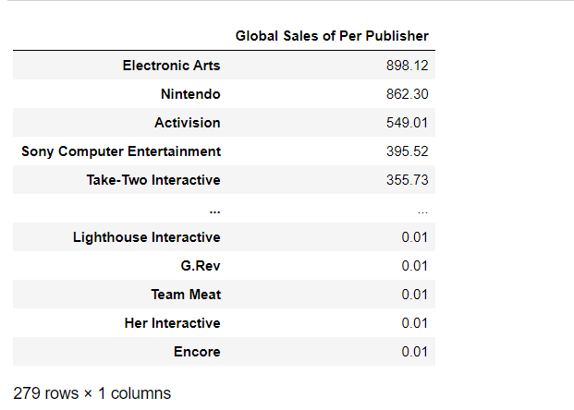
# Group Project Part 4
# Total sales of each major publisher
Clean game_data
Get total sales of each publisher globally by year
Use .sort_values to rank

Slide 2
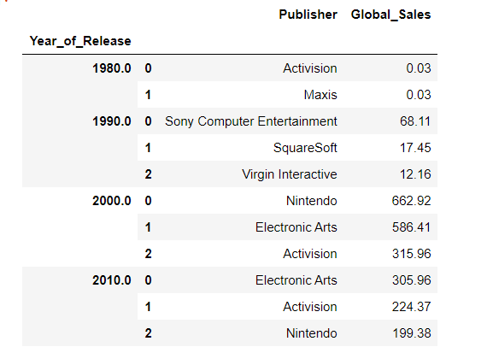
# Group Project Part 4
Create bins and count for games that have been published for each decade
Use columns = [y.Publisher, (y.Year_of_Release//10)*10] to create two columns and year gaps
Create a lambda x: x[columns].sort_values(by ='Global_Sales’) to sort the maximum Global Sales value in each decade

Slide 3
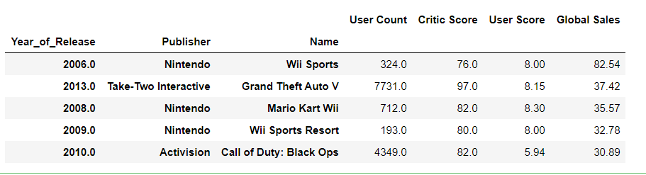
# Group Project Part 4
# The most profitable & popular games overall
Define a function called analysis
Include 4 keys(columns) and show the new data frame
Use n.largest to nest down the top 5 games

Slide 4
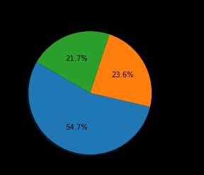
My question
# Top 3 most profitable games (pie chart) overall
This pie chart regarding three video games overall that have the most global sales does not match the games in ‘gamedata.’

